Slide 1


INNOVATION. AUTOMATION. ANALYTICS
PROJECT ON
HOSPITAL OPERATIONS
SQL ANALYTICS PROJECT
Turning hospital operations into an analyzable data model
Presented by Abhinav Yadav
SQL • Database Design • Business Analysis

Slide 2
About Me
Individual project — handled independently.
Academic Background
Why Data Science?
B.Tech student / graduate with a technical focus on data-oriented problem solving and database fundamentals.
I want to learn how raw information can be cleaned, structured, analyzed and converted into useful business insights.
Work Experience
Profiles
Data Science internship experience with Cognifyz Technologies and Edu Expose Foundation.
LinkedIn: linkedin.com/in/abhinavyadav2705
GitHub: github.com/abhinavyadav27
ROLE
Project planning • SQL schema design • Query writing • Analysis framing • Presentation
2

Slide 3
Table of Contents
Presentation flow based on the Innomatics SQL project template.
1
Project Overview
6
Analysis of the Objectives
2
Business Scenario
7
Overall Key Findings
3
Business Objectives
8
Business Recommendations
4
Dataset & Database Overview
9
Conclusion
5
ER Diagram & Database Structure
10
Q&A
3

Slide 4
Project Overview
SQL-based hospital operations database designed for operational analysis.
PROJECT PURPOSE
Create a connected hospital database that supports demand analysis, treatment-performance monitoring, workforce analysis, and room/equipment utilization.
Patient Lifecycle
Scheduling Layer
Execution Layer
Patient profile → registration → appointment → treatment → outcome
Services, priorities, estimated cost and booking channels are captured through appointments.
Treatment status, duration, waiting time, attempts, doctor and room context are captured.
PROJECT SCOPE
Database: hospital_operations | Five connected core tables | SQL schema + analytical query logic | Focus on operational questions rather than fabricated result values
4

Slide 5
Business Scenario
How the database represents the day-to-day hospital workflow.
1
2
3
4
5
PATIENT
APPOINTMENT
TREATMENT
DOCTOR
ROOM
Profile, city,
patient type
Service, priority,
channel, cost
Status, attempts,
duration, waiting
Specialty, rating,
workforce
Capacity,
equipment
MANAGEMENT QUESTIONS
▸ Where is appointment demand concentrated?
▸ Which services and priorities create longer waits or more non-completion?
▸ How do doctors, rooms and equipment contribute to throughput?
▸ Where do repeated treatment attempts indicate possible operational friction?
5

Slide 6
Hospital Operations Flow Chart
End-to-end operational workflow captured in the database.
1
Patient Registration
Patient profile, city, patient type (General / Corporate / Insurance)
2
Appointment Booking
Service type, priority, booking channel, estimated cost, appointment date
3
Doctor Assignment
Specialty match, rating, employment type, active status
4
Treatment Execution
Room & equipment allocation, treatment duration, waiting time, attempts
5
Outcome & Status
Completed / In Progress / Rescheduled / Cancelled / No-Show
6

Slide 7
Business Objectives
The SQL project is structured around measurable operational questions.
01
Understand patient demand
02
Measure service demand
Identify patients with multiple appointments and compare activity by patient type.
Compare service types, priorities, channels and appointment activity.
03
Monitor treatment performance
04
Evaluate doctors
Analyze treatment duration, waiting time, attempts and status.
Compare treatment volume with specialty, rating and employment context.
05
Understand room utilization
06
Find exception patterns
Relate treatment activity to room type, equipment and capacity.
Look for repeated attempts, non-completion and city/service friction points.
7

Slide 8
Dataset & Database Overview
The supplied project is a relational SQL schema, not a CSV dataset.
DATABASE
5 CORE TABLES
hospital_operations
patients • doctors • rooms • appointments • treatments
Table | Primary Key | Main analytical role
patients | patient_id | Profile and segmentation
doctors | doctor_id | Provider and quality context
rooms | room_id | Physical resource inventory
appointments | appointment_id | Demand and booking behavior
treatments | treatment_id | Actual service delivery and outcome
DATA AVAILABILITY NOTE
The supplied SQL contains schema definitions and analytical queries, but no INSERT statements or query outputs. Therefore, this presentation does not invent numeric results.
8

Slide 9
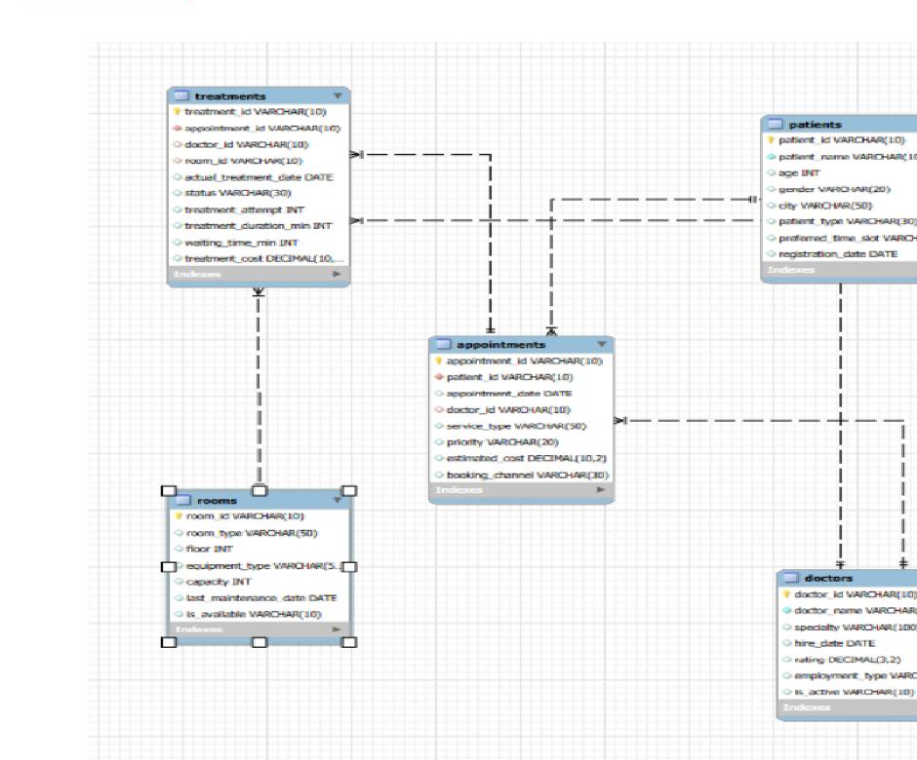
ER Diagram & Database Structure
Supplied ER diagram showing patient → appointment → treatment traceability.
Relationship Logic
patients → appointments via patient_id
doctors → appointments & treatments via doctor_id
appointments → treatments via appointment_id
rooms → treatments via room_id
Database Structure
Primary keys identify each record. Foreign keys create traceability across patients, doctors, rooms, appointments and treatments.
9

Slide 10
Analysis of the Objectives — Demand
SQL logic used to understand who books, what they book and how demand is distributed.
Multiple Appointments
Conceptual View — Demand Lenses
GROUP BY patient_id + HAVING COUNT(*) > 1 — identifies patients with repeated bookings.
Patient Type
JOIN patients + appointments — compare General, Corporate and Insurance activity.
Service & Priority
JOIN appointments + treatments — compare volume and waiting time by service/priority.
City & Channel
Analyze appointment volume by city and booking channel over time.
10

Slide 11
Analysis — Treatment Outcomes & Experience
SQL logic connecting demand to delivered care.
Treatment Status
Status Dimensions to Monitor
Group by status: Completed, In Progress, Rescheduled, Cancelled, No-Show.
Treatment Duration
AVG / MIN / MAX treatment_duration_min by service or operational dimensions.
Waiting Time
Compare average waiting_time_min by service, priority, city and attempts.
Repeated Attempts
MAX(treatment_attempt) > 1 highlights appointments needing review.
PATIENT EXPERIENCE LENS: Appointment → Treatment → Duration + Wait → Outcome
11

Slide 12
Analysis — Doctors, Rooms & Resources
Linking throughput to people and physical resources.
Doctor Performance
Room & Equipment
• Treatment volume by doctor
• Outcome distribution
• Avg / min / max treatment duration
• Specialty, rating, employment type, active status
• Treatment volume by room type / equipment
• Average duration and waiting time
• Average treatment cost
• Capacity, availability and maintenance context
Interpretation Rule
Resource Decision Lens
Doctor ratings and throughput should be read alongside case mix, specialty, workload, service type and outcome definitions.
Use the model to compare throughput, experience and resource use, then investigate the drivers behind differences.
12

Slide 13
Overall Key Findings
Findings supported by the database design and query logic — not fabricated numeric outcomes.
Connected operational model
Multiple analytical lenses
The five tables create a traceable patient-to-treatment workflow.
Demand, treatment experience, workforce and resource utilization from one schema.
Operational exceptions are visible
Time and location matter
Repeated attempts and non-completion statuses can be isolated for review.
Date, month and city dimensions support demand and performance comparisons.
Data quality needs production controls
Results depend on loaded data
Validation, constraints, indexes and controlled values before production use.
Numeric findings can only be confirmed after data is populated and queries run.
13

Slide 14
Business Recommendations
Practical actions that follow from the analytical framework.
01
Prioritize wait-time monitoring
02
Review repeat-attempt cases
Track average waiting time by service, priority, city and treatment attempts.
Create a review workflow for appointments requiring multiple treatment attempts.
03
Monitor non-completion
04
Balance workforce and resources
Use Cancelled, No-Show and Rescheduled patterns to identify access issues.
Compare doctor workload with room/equipment utilization before changing capacity.
05
Strengthen data quality
06
Load real operational data
Add NOT NULL/CHECK controls, valid ranges, FK indexes and controlled Yes/No values.
Run the SQL against populated data and convert outputs into dashboards/KPIs.
14

Slide 15
Conclusion
What this project demonstrates.
A structured SQL database can turn hospital operations into a clear analytical workflow.
• Designed five connected entities for patients, doctors, rooms, appointments and treatments.
• Used primary keys and foreign keys to maintain traceability across the hospital workflow.
• Created SQL questions for demand, treatment outcomes, patient experience, workforce and resource analysis.
• Built an exception-analysis framework for repeated attempts and non-completion patterns.
• Kept the presentation evidence-based: no numeric results were invented because the supplied SQL has no loaded data/output.
KEY LEARNING
Database design → Relationships → SQL queries → Business questions → Actionable analysis
15

Slide 16
Q&A
QUESTIONS?
Hospital Operations SQL Analytics Project
Presented by Abhinav Yadav
Thank you for your time. I am ready for questions.
16

Slide 17

THANK YOU
Hospital Operations SQL Analytics Project
Presented by Abhinav Yadav

